Slide 1
Top-N Recommendation & Other Issues
YANG Chunfeng(yannisyang)
yc012@ie.cuhk.edu.hk
yannisyang@tencent.com

Slide 2
Agenda
Top-N recommendation related issues
Issues concerned in last week’s (2014-2-13) group meeting

Slide 3
Agenda
Top-N recommendation related issues
Issues concerned in last week’s (2014-2-13) group meeting

Slide 4
Top-N recommendation related issues
Preliminary and Definition
Motivation and Task
Key issues concerning top-n recommendation
Common for explicit and implicit feedback
For explicit feedback
For implicit feedback
Overview of Algorithms

Slide 5
Top-N recommendation related issues
Preliminary and Definition
Motivation and Task
Key issues concerning top-n recommendation
Common for explicit and implicit feedback
For explicit feedback
For implicit feedback
Overview of Algorithms

Slide 6
Preliminary
Data sources and recommendation approaches
Social connections → social filtering (user cold start)
User demographic info (user profile)→demographic filtering (user cold start)
Feedback → collaborative filtering (domain-independent)
Explicit & Implicit
Internal & External (relative to video website)
Item profiles → content-based filtering (item cold start)

Slide 7
Preliminary (cont.)
Evaluation of Recommender System
Approaches
Online deployment, survey/questionnaire, offline testing
Three participants: users/consumers; content providers; video websites
Metrics (tradeoff, and integrated evaluate)
Satisfaction (QoE), hidden potential content discovery → for users/consumers
Accuracy (precision & recall, CTR), users’ total devoted time→ for video website
Coverage (discovery of long tail)→ for content providers
Real-time: new ratings, new users, new items; change rate of recommended list
Diversity; Novelty; Serendipity(惊喜度);Robustness

Slide 8
Methods to deal with data sparsity
Preliminary (cont.)
Extra data sources
User profile/demographic info
Item profile
social relations
other internal activities: such as tag, comment, query, browse, purchase, etc.
external activities: video-related activities in other social networks
Dimensionality Reduction: SVD, PCA, LDA
Random Walk: on Social graph, Behavioral graph
Non-personalized method: popularity-based(can deal with user cold-start).

Slide 9
Explanation and Scalability
Preliminary (cont.)
Social Explanation
Persuasive vs. informative explanation
Likelihood rating (likelihood to check out) vs. consumption rating(actual rating)
social explanation vs. inherent expectation
Social explanation may improve likelihood rating
Privacy issue
Scalability
As shown later, all ratings(including unrated ones) needed to be considered: efficiency issue.
For top-n recommendation, some processing can be simplified to realize scalability (such as use k nearest neighbors, remove denominator, vote-based instead of weighted average, ALS in MF as shown later) .

Slide 10
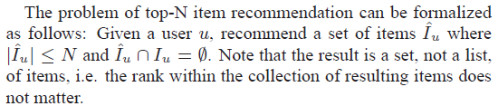
Definition of Top-N recommendation

Slide 11
Top-N recommendation related issues
Preliminary and Definition
Motivation and Task
Key issues concerning top-n recommendation
Common for explicit and implicit feedback
For explicit feedback
For implicit feedback
Overview of Algorithms

Slide 12
Motivation
Top-N recommendation is more relevant in practical applications than rating prediction.
Improvements in RMSE often do not translate into accuracy improvements.
Rating prediction results won’t recommend those videos that users will view but may not rate high.
In Top-N recommendations, a recommender is trying to pick the best 10 or so items for someone. It does not matter if you cannot predict what people will hate. The only thing that matters is picking 10 items someone will love.
Need some modifications in order to optimize the performance for top-n recommendation.

Slide 13
Tasks
Two sorts of input
Explicit feedback
numerical value, such as 1~5
little or no noise
small amount
indicate preference
Implicit feedback
binary value, 0 or 1
more noise
large amount
indicate confidence (frequency, view ratio)
Two sorts of problems (output)
rating prediction
predicted rating values
continuous numerical value within 1~5
top-n recommendation
a list contains n items ranked in the first n candidates

Slide 14
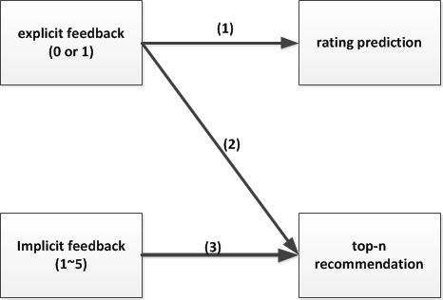
Tasks (cont.)
(1). Traditional rating prediction problem
(2). Top-n recommendation with explicit feedback
(3). Top-n recommendation with implicit feedback
(2),(3) will be covered and discussed in this talk

Slide 15
Top-N recommendation related issues
Preliminary and Definition
Motivation and Task
Key issues concerning top-n recommendation
Common for explicit and implicit feedback
For explicit feedback
For implicit feedback
Overview of Algorithms

Slide 16


Common issues for top-n recommendation with explicit and implicit feedback
Better to training the objective function via including all records(with unobserved ones) for optimization.
Missing rating/value treatment

Slide 17
Common issues for top-n recommendation with explicit and implicit feedback (cont.)
The testing set should be chosen carefully in order to not bias accuracy metrics when evaluating the performance.
A little few top popular items can skew the top-N performance: remove the hottest few items; keep more eye on long-tail part than short-head part.
Similarity Measures
better to use cosine coefficient than Pearson correlation coefficient since it’s computed over all ratings.
Conditional probability between two items(like concept of “confident” in Association Rule).

Slide 18
Evaluation (explicit & implicit)
Relevance
For explicit feedback(numerical): value large than a threshold (such as average value) indicates relevance (less than it will be irrelevant).
For implicit feedback(binary): 1 indicates relevance. Value 0 cannot properly be considered as irrelevant since the no-action on an item can be due to many other reasons beyond not liking it (the user can be unaware of the existence of the item.
Accuracy (using relevant records)
Precision
Recall
Remove the hottest few items for evaluation(remove test bias).

Slide 19
Top-N recommendation related issues
Preliminary and Definition
Motivation and Task
Key issues concerning top-n recommendation
Common for explicit and implicit feedback
For explicit feedback
For implicit feedback
Overview of Algorithms

Slide 20


Key issues concerning top-n recommendation with explicit feedback
Can use rating prediction methods for top-N item recommendation by ranking the predicted rating of all items without observed rating.(serve as proxies)
Do not need to get exact rating values. Relative scores (association measure) are enough for correct item ranking.
This can used for simplicity to scale:

Slide 21
Key issues concerning top-n recommendation with explicit feedback (cont.)
Missing ratings/values treatment
Special treatment for unrated ones (missing rating) since ratings are missing not at random(biased). Low ratings are typically much more likely to be missing.
Two approaches to handle.
Impute small constant rating value rm for unobserved ratings.
Give smaller weight to prediction errors for unobserved ratings.

Slide 22
Top-N recommendation related issues
Preliminary and Definition
Motivation and Task
Key issues concerning top-n recommendation
Common for explicit and implicit feedback
For explicit feedback
For implicit feedback
Overview of Algorithms

Slide 23
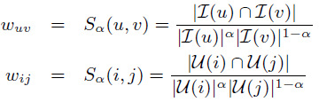


Key issues concerning top-n recommendation with implicit feedback
Often, only implicit feedback data is available.
For top-n recommendation with implicit feedback
cosine similarity for binary rating
suitable scoring function

Slide 24



Key issues concerning top-n recommendation with implicit feedback (cont.)
Missing ratings/values treatment
Give different confidence level(c) to prediction errors for unobserved ratings.
Feedback confidence(r)
frequency, view ratio
0~m → binarize

Slide 25
Top-N recommendation related issues
Preliminary and Definition
Motivation and Task
Key issues concerning top-n recommendation
Common for explicit and implicit feedback
For explicit feedback
For implicit feedback
Overview of Algorithms

Slide 26
Top-N recommendation Algorithms
Collaborative filtering
Memory-based (neighborhood approach): user-user or item-item
one-hop: user-based; item-based; association rule;
multi-hops(graph-based): random walk
Model-based (latent factor approach): user-item
SVD, Neural Network(such as RBM)
Algorithms using social network
Probabilistic methods: PLSI, LDA, PMF, Bayesian Network

Slide 27
Bias Removal
Remove multiple biases
take into account user/item rating records amount when calculating user/item similarity (significance weighting in CF)
user/item effects: some users like to give higher rating than other users; some items always get higher ratings than other users (when aggregating to obtain the predicted score) (with explicit feedback) (adjusted cosine similarity)
temporal effects (for explicit feedback)
anchoring: overall average ratings varies with time
preferences evolve: with product/item age
seasonal effect

Slide 28
Top-N Recommendation Using Social Network
Opinion leader-based filtering
Trust-based(through random walk approach)
MF using social network

Slide 29
Agenda
Top-N recommendation related issues
Issues concerned in last week’s (2014-2-13) group meeting

Slide 30
Other issues
Opinion leader
Utilize user profile (demographic info)
Graph-based algorithms
Content-based algorithms
Two Ideas

Slide 31
Other issues
Opinion leader
Utilize user profile (demographic info)
Graph-based algorithms
Content-based algorithms
Two Ideas

Slide 32
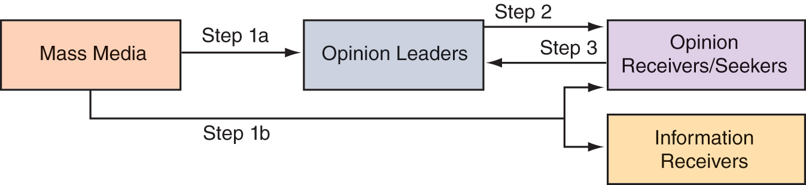
Motivation of Opinion Leader
Multistep Flow of Communication Theory

Slide 33
Characteristics of Opinion Leaders
An Opinion Leader is Someone Who is Knowledgeable About Products and Whose Advice is Taken Seriously By Others.
Are Often Among
the First to Buy
New Products
Are Technically
Competent and Have Expert Power
Opinion
Leaders
Are Similar to
the Consumer in
Values and Beliefs
Have Prescreened,
Evaluated, and
Synthesized
Product Information
Are Socially
Active in
Their Community

Slide 34
Detection of Opinion Leader
Celebrities: such as those in microblog
Self-Selection: Volunteer
Self-Identification: Through suitable questionnaires for whether self can be an opinion leader.
Staff Selected: Selected by others in the community
Positional Approach: persons who occupy leadership positions such as business elites, elected officials
Expert Identification: detected by experts
Graph-based Method: through network analysis

Slide 35
Detection of Opinion Leader (cont.)
Graph-based
In the specific social network/graph (such as microblog, QQ, Wechat)
Metrics in SNA(social network analysis)
Degree Centrality
Betweenness Centrality
Closeness Centrality
Eigenvector Centrality
Clustering Coefficient

Slide 36
Opinion leader-based filtering
Similar to the function of social explanation
Better for active recommendation rather than passive prediction

Slide 37
Other issues
Opinion leader
Utilize user profile (demographic info)
Graph-based algorithms
Content-based algorithms
Two Ideas

Slide 38
Demographic Filtering
Ease the user cold start problem
Demographic information can be used to identify the types of users that like a certain object (using machine learning approach such as rule induction(decision tree, association rule), classification). Such as ads targeting
There is a trade-off between the quality of the demographic information obtained and the amount of effort required to obtain it.

Slide 39
Graph-based algorithms
Graph formulation
Random Walk
Two-layer graph
Multidimensional graph

Slide 40
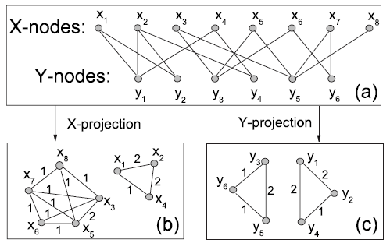
Graph-based:
Social graph/web of trust: real social connections
Behavioral/Correlation graph: co-viewed/co-rated/co-tagged/co-reviewed graph
(Bipartite graph/Affiliation Network, such as user-item rating matrix, can be converted to such graph(Markov network/Markov Random Fields)：Bipartite network projection(one-mode) )
Bipartite graph
One-mode graph
(behavioral graph/correlation graph)

Slide 41
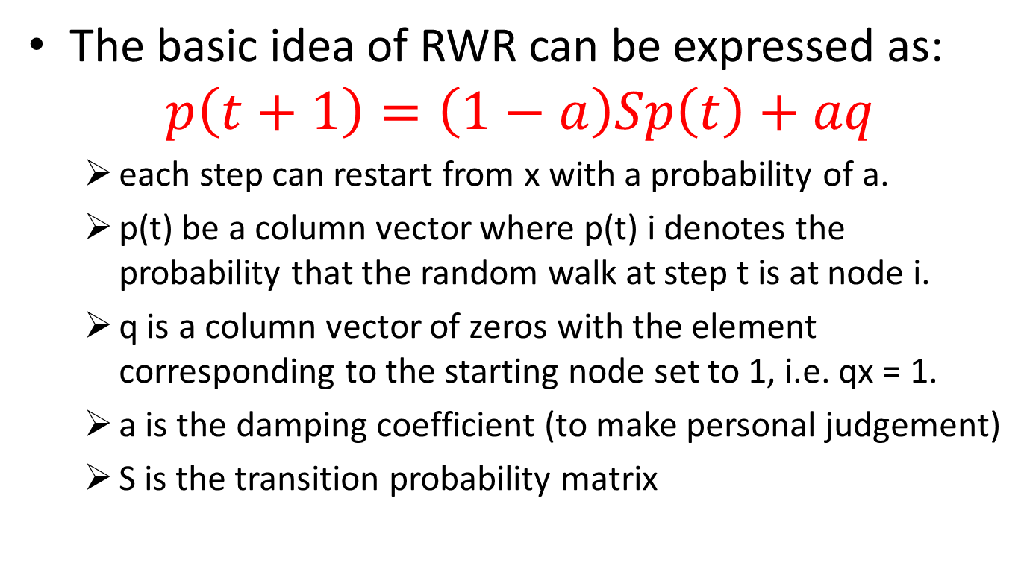
Random Walk with Restart (RWR)
The basic idea of RWR can be expressed as:
$$p\left(t+1\right)=\left(1−a\right)Sp\left(t\right)+aq$$
each step can restart from x with a probability of a.
p(t) be a column vector where p(t) i denotes the probability that the random walk at step t is at node i.
q is a column vector of zeros with the element corresponding to the starting node set to 1, i.e. qx = 1.
a is the damping coefficient (to make personal judgement)
S is the transition probability matrix
Almost the same as Google topic-specific PageRank with random teleport

Slide 42
Random Walk with Restart (cont.)
If we want to recommend resources to user i, we will mark node i as the starting node.
q is a vector in which the element corresponding to the starting node is set to 1.
So it should be easily accessible to the node which is closer to the starting node that they would get greater stationary probabilities.
Therefore, after the iteration converges, we sort the nodes with their stationary probabilities. The node with larger stationary probability is closer to the target node

Slide 43
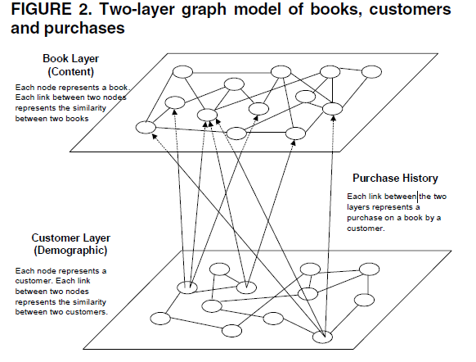
Two-layer graph
Integrate demographic info, preference feedback and item profile

Slide 44
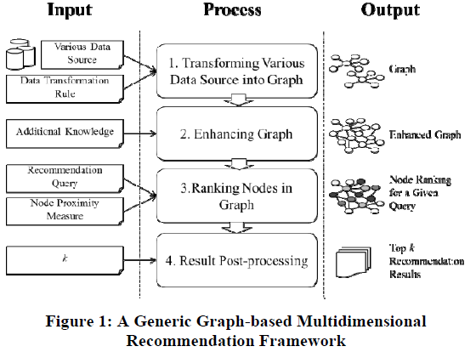
Multidimensional graph
Homogeneous Graph-based Method
Heterogeneous Graph-based Method

Slide 45
Other issues
Opinion leader
Utilize user profile (demographic info)
Graph-based algorithms
Content-based algorithms
Two Ideas

Slide 46
Content-based algorithms
Suitable for textual item/content
Procedure:
Item profiling (text mining)
user preferences
User profiling
Comparison between user and item profile

Slide 47
Content-based algorithms (cont.)
Regression-based
Text mining: TF-IDF ,Topic modeling(LDA,PLSI)
LDA acts for feature extraction and dimensionality reduction
LDA can be combined with Naive Bayes(NB), K-Nearest Neighbor(kNN), Regression and Regularized Linear Regression, Linear Classifier, etc.

Slide 48
Regression-based
Feature weighting:
Key Idea: different weight on features
Debnath et. al. Feature Weighting in Content Based Recommendation System Using Social Network Analysis. WWW’08 Poster.
Methodology
-- rating matrix → movie “co-like” social graph
-- movie profile (14 features) → movie distance
-- S(m1, m2) = w1*dist1(m1, m2) + … + wi*disti(m1, m2) + ...
-- Linear Regression → wi

Slide 49
More on Association Rule
AR with larger basket(consider cases with the basket size larger than two, such as A+B→C).
AR + random walk: item A → item B with confidence of p (0~1) with can be regarded as the strength (transfer probability) of the link with node A and B in the gradually constructed associated graph (directed graph).

Slide 50
Other issues
Opinion leader
Utilize user profile (demographic info)
Graph-based algorithms
Content-based algorithms
Two Ideas

Slide 51
--Combined Association Rule-based and Content-based top-N Recommendation
Ideas-I
Diversity by AR
AR is well-suitable for top-N recommendation
No item cold-start by CB
Relevance/Similarity by CB
Combination of respective results

Slide 52
--A random walk model combining social filtering and association rule for top-N recommendation
Ideas-II
No user cold-start by social filtering
Ease data sparsity by random work
Diversity by AR
AR is well-suitable for top-N recommendation
Merge in the process/formulation (two-layer graph)

Slide 53
Questions
An Overview of Tencent Video Recommendation System.
Data Availability and Access.
Social Recommendation.
Notes:
1.Measure the online performances(CTR, QoE) of various algorithms and their combinations
2. Measure the temporal prediction distribution of recommendation in tencent video

Slide 54
Thanks for your attention Q & A

Slide 55
Describe the current Tencent video system; and its recommender system:
use different algorithms in different scenarios
use different algorithms for different types of videos

Slide 56
Context-aware recommendation
Context
Query
Temporal effect
XX

